Slide 1







ArcGIS API for JavaScript: Dynamic Vector Symbology
Anne Fitz, Kristian Ekenes, and Russell Roberts
https://arcg.is/1STzGK0
2021 ESRI DEVELOPER SUMMIT

Slide 2


Agenda
What are CIM Symbols?
Create a symbol from scratch
Creating a web style
Data-driven CIM

Slide 3


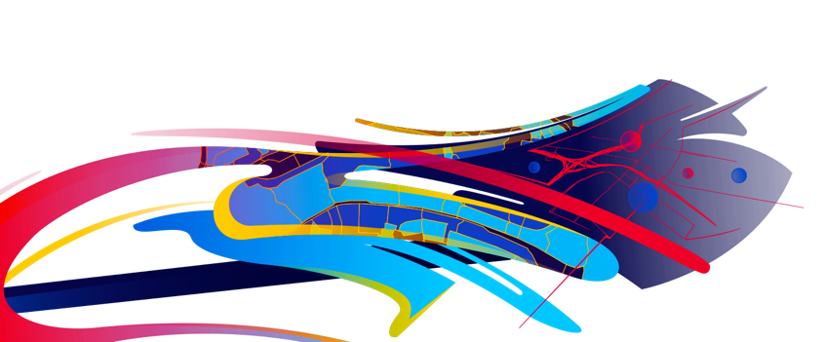




What are CIM Symbols?
Anne Fitz

Slide 4





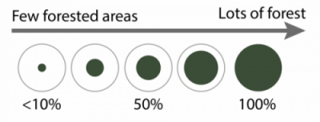
CIM Symbols
High quality, scalable
Symbol layers
Symbol
layer1
layer2
layer3
Scaled vector symbol
Scaled image
Primitive Overrides
Dynamically update attributes of an individual symbol layer using Arcade

Slide 5
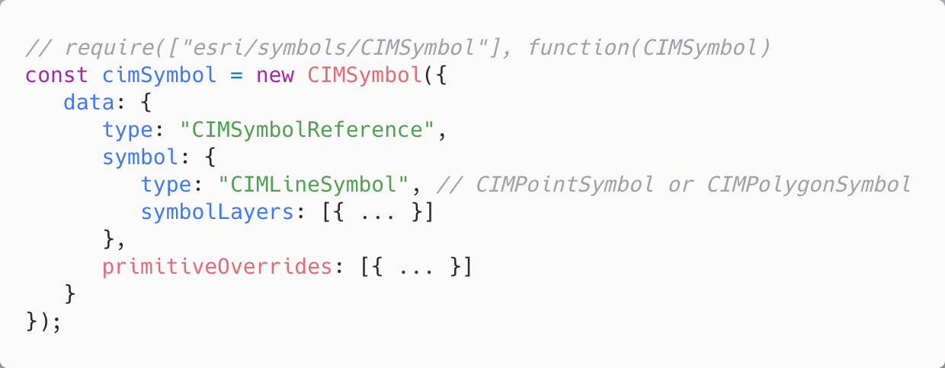
How is it used in the ArcGIS API for JavaScript?
follows the cim-spec

Slide 6
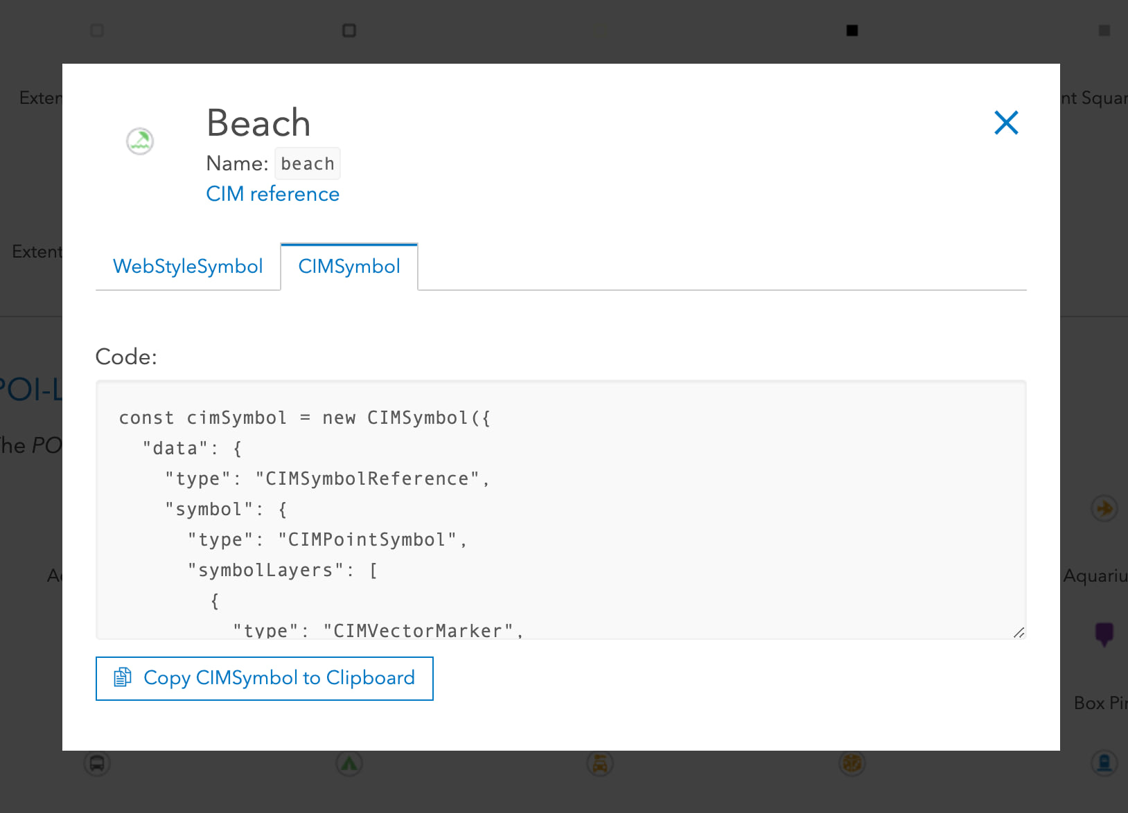
WebStyleSymbols
Predefined 2D CIM symbols that you can conveniently reference in your apps
Esri WebStyleSymbols (2D) guide page
Create your own web style symbols

Slide 7



CIMPointSymbol
CIMPictureMarker
CIMVectorMarker
CIMTextSymbol
Created from raster image file
Represents vector graphics
Constructed from MarkerGraphics
Supported as a marker graphic on a CIMVectorMarker symbol layer

Slide 8
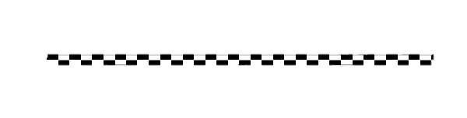
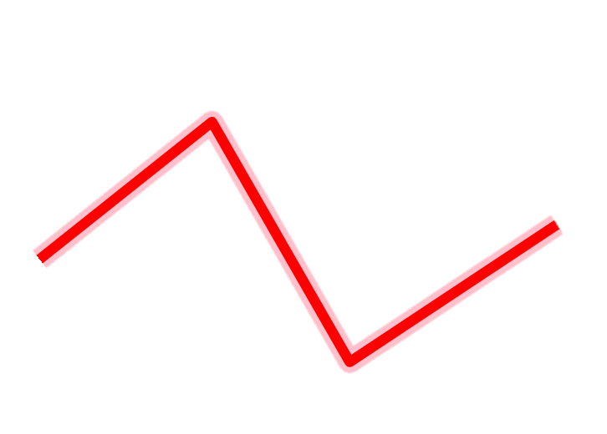


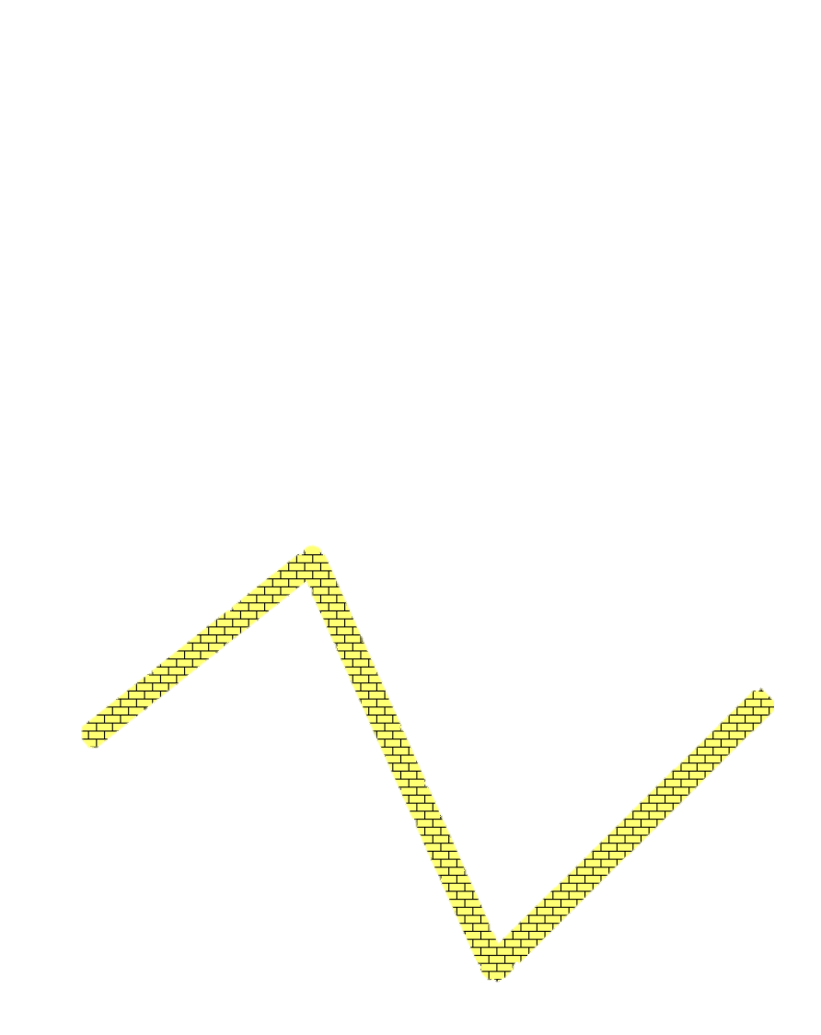

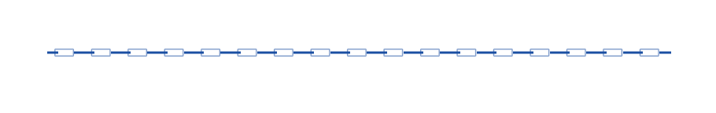
CIMLineSymbol
Geometric Effects
Dashes
Buffer
Arrows
Marker placement
CIMSolidStroke
CIMPictureStroke

Slide 9

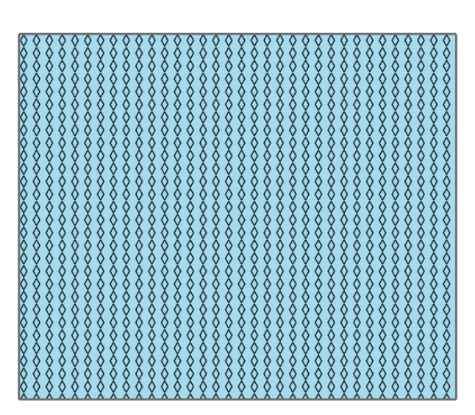

CIMPolygonSymbol
CIMSolidFill
CIMHatchFill
CIMPictureFill

Slide 10
Create a symbol from scratch
Anne Fitz

Slide 11

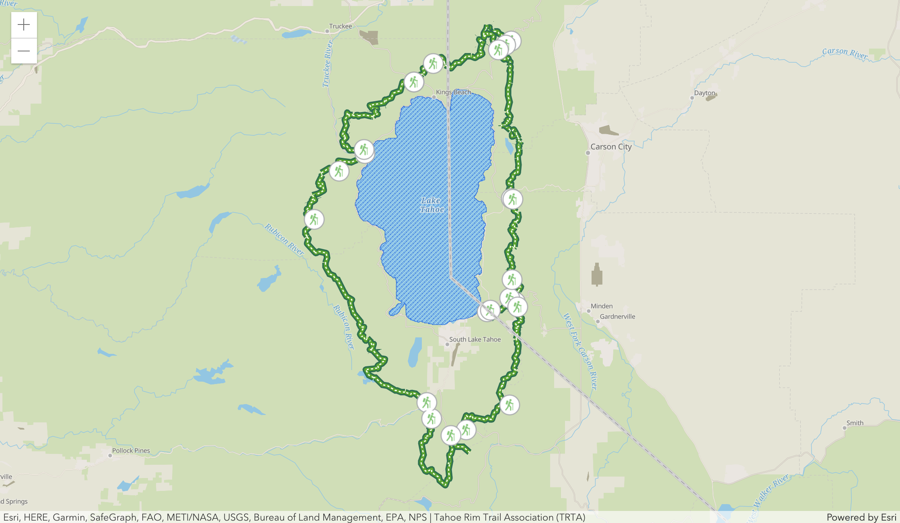


CIM Starter App
Anne Fitz

Slide 12
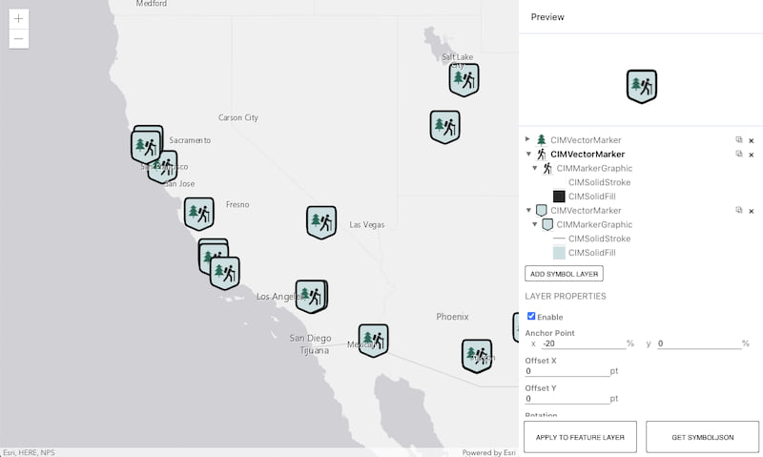
CIM Symbol Builder

Slide 13
Creating a Web Style
Russell Roberts

Slide 14
How to create a Web Style
Share web styles with ArcGIS Pro 2.6 and up
Currently only points supported
For 2D Web Styles publish picture or shape marker
Vector symbols can be .svg or .emf format with shape marker
Use them in web maps and 4.x web apps, runtime 100.x apps and Pro.
Map Viewer Beta, Experience Builder, Dashboard Beta and more

Slide 15
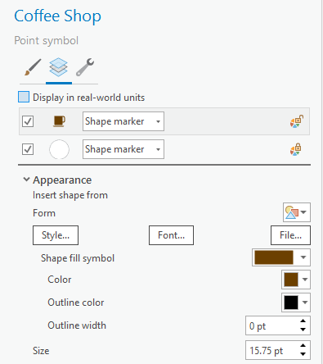
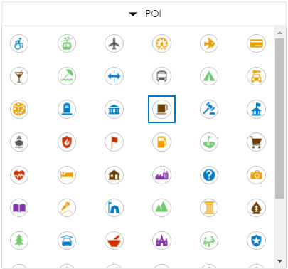
Creating a WebStyle
Russell Roberts

Slide 16
Data-driven CIM
Kristian Ekenes

Slide 17
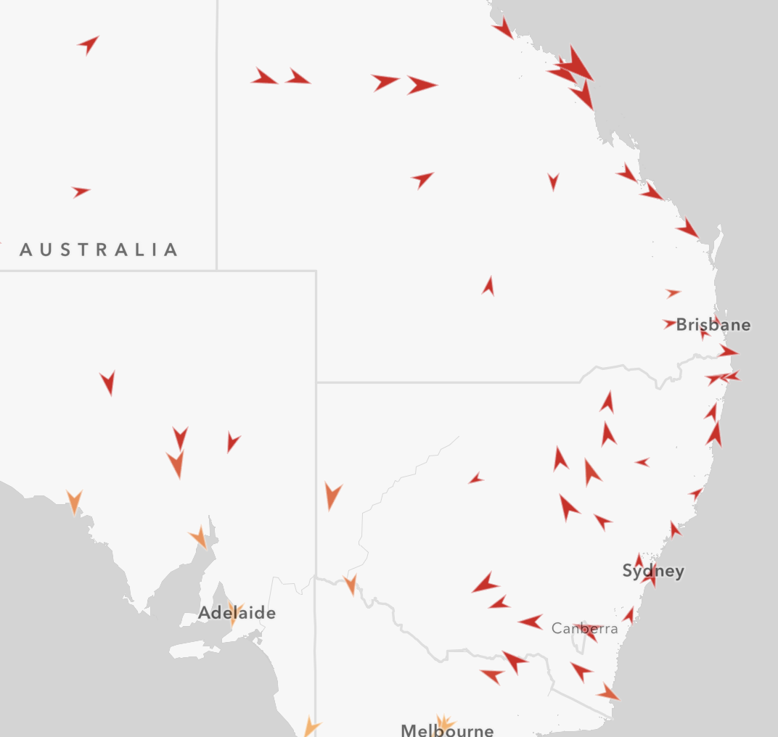
Data-driven mapping
Override a symbol’s visual variable with a data value (either a field value, or an Arcade expression).
opacity
rotation
size
color

Slide 18
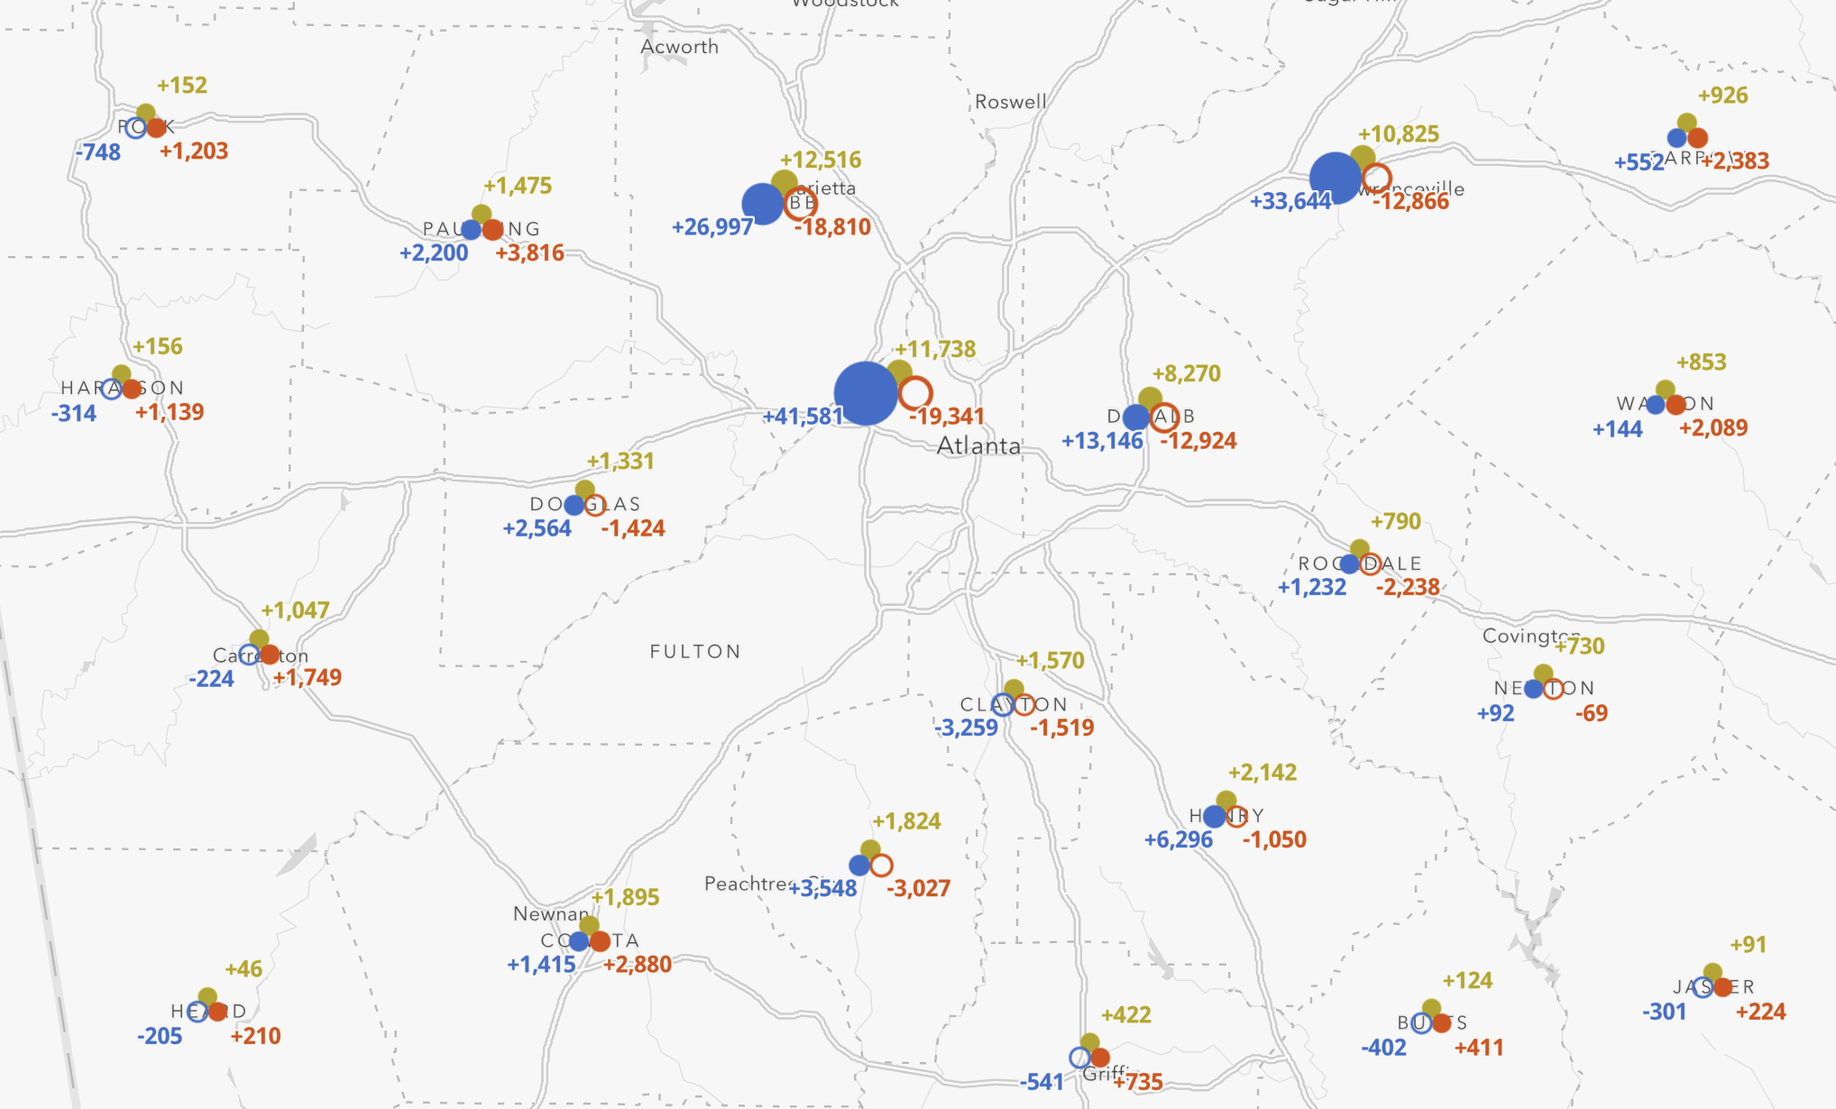
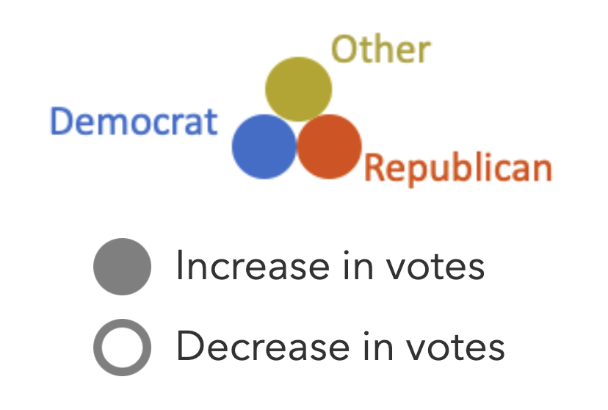
Multi-part data-driven symbols
Multiple symbol layers.
The visual properties of each can be controlled by data values, so you can create more complex, multi-part, data-driven visualizations.
More complex usually isn’t a good thing, but it can be!

Slide 19
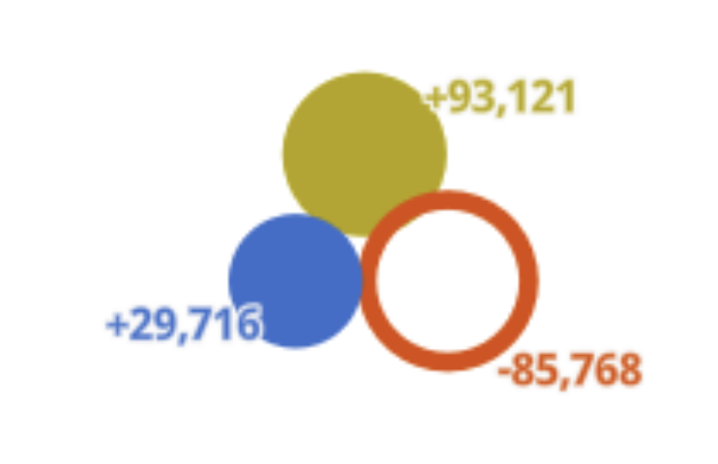
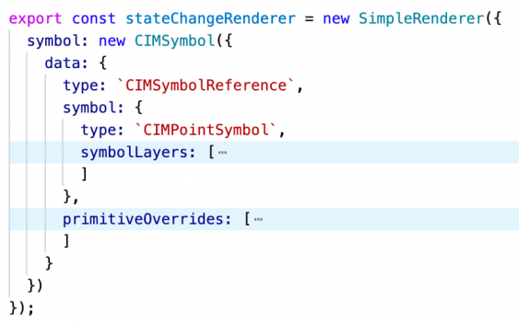
Primitive Overrides
A property of CIMSymbol.
Arcade expressions that dynamically return the value of a primitive’s visual property.
e.g. a primitive override targeting size returns a new size value for a targeted symbol layer (primitive).
Typically used to change a symbol property based on a data value or expression.

Slide 20
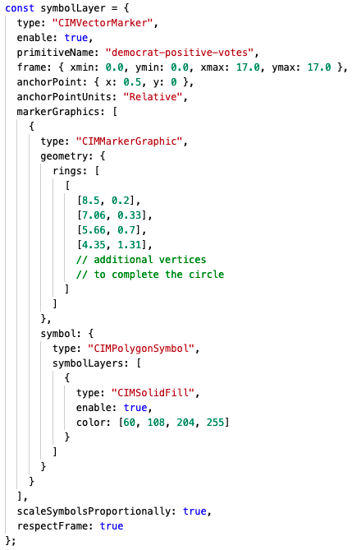
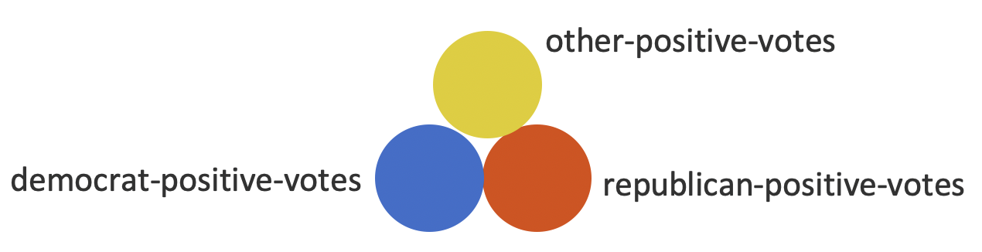
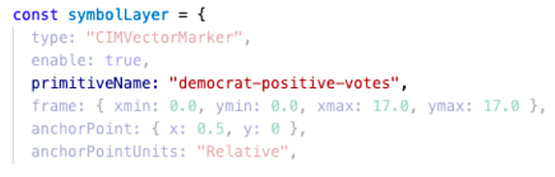
Primitive Overrides

Slide 21
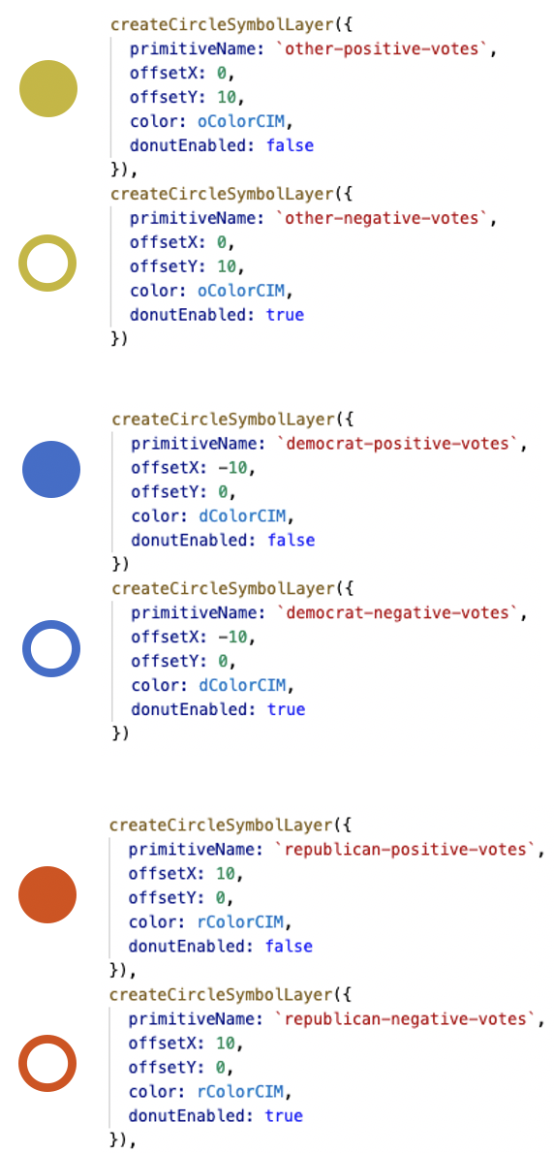

Primitive Overrides

Slide 22
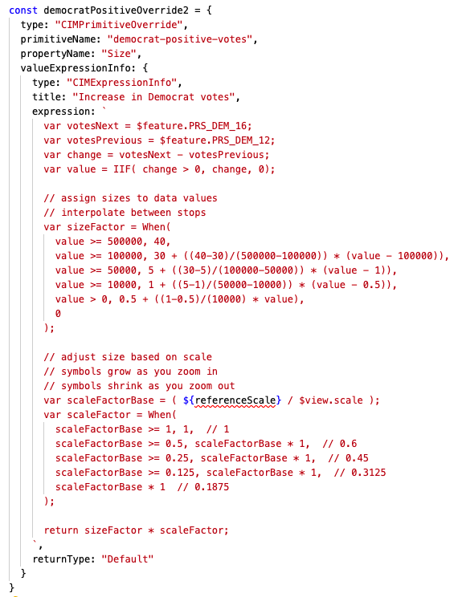
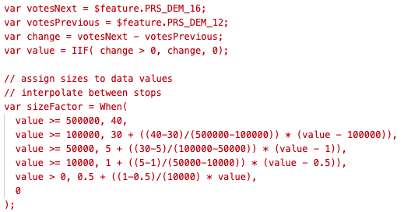
Primitive Overrides

Slide 23
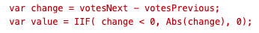
Primitive Overrides
Computed sizes
10.82
3.97
10.36
All other symbol layers are assigned a size of zero, and therefore aren’t drawn.

Slide 24






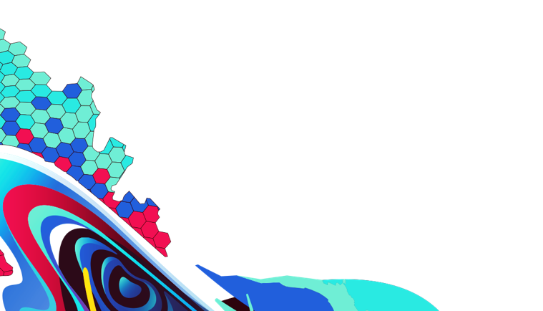
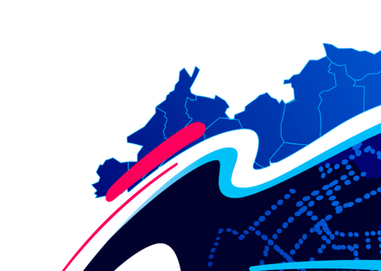
Please provide your feedback for this session by clicking on the session survey link directly below the video.

Slide 25

Copyright © 2021 Esri. All rights reserved.

